Slide 1
Challenge yourself and join GC Europe Academic Excellence Contest!

Slide 2
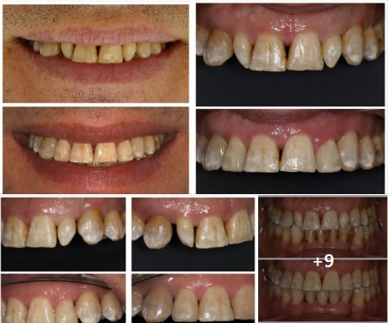
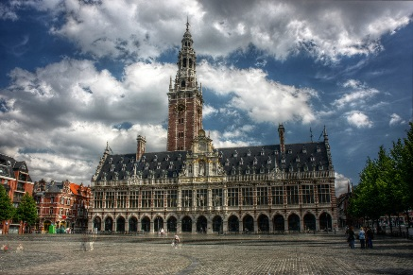
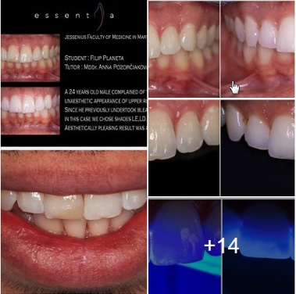
GC Academic Excellence Contest - flow
Junior & Senior cases/university – only 1 accepted per student
Case posted on FB/Instagram between 1st Jan & 5th June 2025
Registration document & CTA signed
National Jury selects the best case in each category
Presentation by national Junior & Senior winners in Leuven, Belgium on 19-20 Sep 2025
2 European winners in each category
+ 1 Facebook winner
+1 Instagram winner
1
2
3
4
5

Slide 3
Rules for National Competition
Who can participate?
All universities can participate
Students can compete in 2 categories:
undergraduate- Junior: Cusp By Cusp Technique in Posterior Class II Teeth
postgraduate students- Senior: Injection Moulding Technique in Anterior Teeth
Each university can submit an unlimited number of cases, but only one case per student will be accepted
Per country a maximum of 40 cases in total ( 20 junior & 20 senior) is accepted

Slide 4
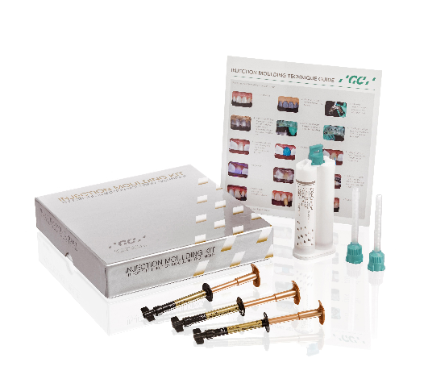
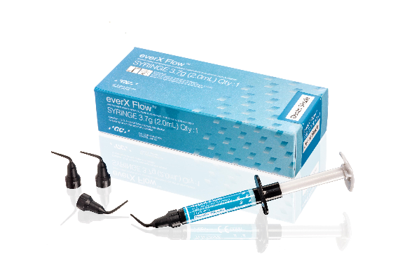
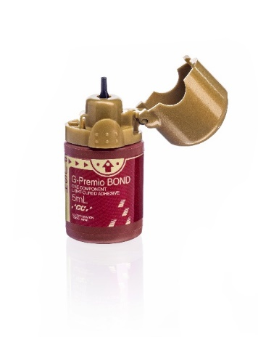
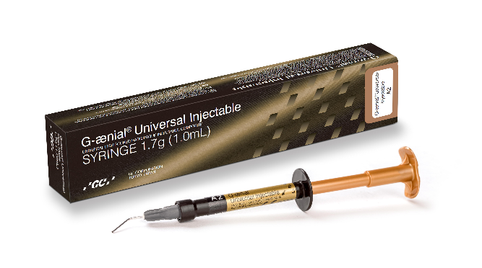
Rules for National Competition
How to participate?
The interested universities will receive a free of charge kit for each student
For students in the Junior category:
G-ænial Universal Injectable, syringe A2
everX Flow Syringe Dentin shade
G-Premio Bond,
Clinical guide, articles and documentation for registration.
For students in the Senior category:
Injection Moulding Kit: G-ænial Universal Injectable Syringe in A1, A2, A3 & Exaclear
G-ænial Universal Injectable, syringe JE,
G-ænial Universal Injectable, syringe A02
G-Premio Bond
Clinical guide, articles and documentation for registration.
This bag/kit will be delivered personally by a GC representative who will explain cusp-by-cusp and Injection Moulding Technique (IMT) and the rules of the contest;
The contest is based on the photographic documentation of a clinical step-by-step case with G-aenial Universal Injectable and everX Flow using cusp-by-cusp technique for undergraduate students and IMT for postgraduate students.

Slide 5
Rules for National Competition
Where and when?
Cases need to be posted on “GC Academic Excellence Contest” open group page in Facebook or Instagram mentioning Name and University and quoting “GC Academic Excellence Contest 2025” between January 1st and June 5th , 2025”. Cases not posted or posted after this date, will not be considered for the contest.
Participants invite their friends to like their case on Facebook/Instagram
Besides publishing their cases on Facebook https://www.facebook.com/groups/gcacademicexcellencecontest / Instagram https://www.instagram.com/gc.academic.excellence.contest/ the participants have to send the following elements to the GC representative:
The case inside the given power point format
The duly filled and signed registration form and the CTA (copyright transfer agreement)
The CTA also includes the right to use pictures of the participants taken during the local & European ceremonies & events. In case this document is not received before the end date of the competition, the participation will not be considered.

Slide 6
PowerPoint presentation template: undergraduate category
Case description
Anamnesis & Age
Chief complaint & expectations from patients
Pre-operative view
1 Occlusal view
Optional: 2 Side views in maximum intercuspidation
Description of treatment plan
Shade selection
Prepared tooth
Matrix placement
Bonding application
Build-up of approximal wall
Placement of everX Flow for dentin replacement
Placement of G-aenial Universal Injectable occlusally using cusp-by-cusp technique
(preferably each step in one picture)
Finishing & Polishing
Final situation
Occlusion check
Final situation at recall
Optional: postoperative x-ray

Slide 7
PowerPoint presentation template: postgraduate category
Case description
Anamnesis & Age
Chief complaint & expectations from patients
Pre-operative view
1 Frontal view with smile
Optional: 2 Side views
Description of treatment plan
Wax-up creation
a. Optional: Impression / scan
b. Optional: creation of the silicone key
Shade selection
Prepared teeth
Bonding application
Fitting of the silicone key
Injection process with G-aenial Universal Injectable
Isolation / moisture control
Injection phase (indicate the used technique with pictures)
Light-curing
10. Finishing & Polishing
11. Final situation
a. Optional: occlusion check
12. Final situation at recall

Slide 8
Rules for National Competition
Criteria for evaluation of clinical cases:
Anamnesis description
Quality of treatment plan
Originality & complexity of the case
Marginal adaptation
Color match & characterization
Anatomical reproduction
Texture
Quality of final result
Quality of pictures
Use of characterization effects
Quality of presentation & Didactics (fluency of speech, aesthetic quality of the slides, clarity of delivered explanations, theoretical knowledge)
Award
A local independent jury will evaluate the cases and selects 1 or 2 winner(s) per category (Junior & Senior).
1st prize winners of each National Contest (1 Junior & 1 Senior student) are awarded with a trip to Leuven to participate in the GC Academic Excellence Contest Final on 19 & 20 September 2025.
The tutors of the Students are also invited to join the event
Additional European Social Media Awards
By encouraging their Facebook and Instagram friends to comment/share/like their cases, 1 student in Europe can also take a chance on winning the Facebook award and another one the Instagram award.
Independent Jury
Junior & Senior awards
Facebook & Instagram Winner

Slide 9
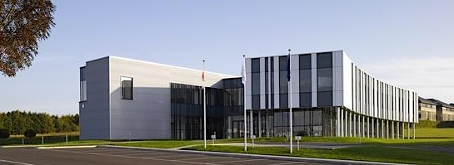
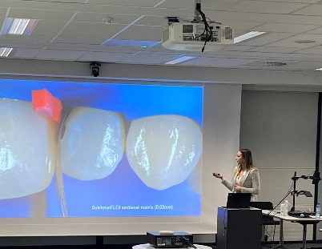
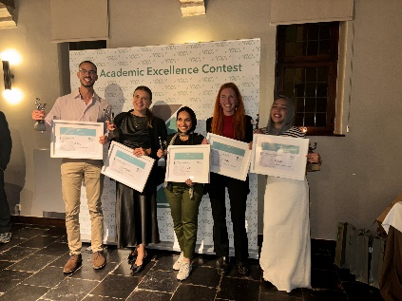
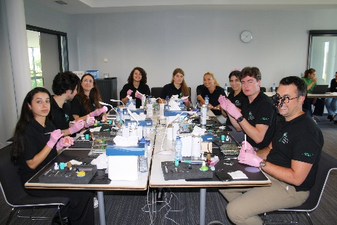
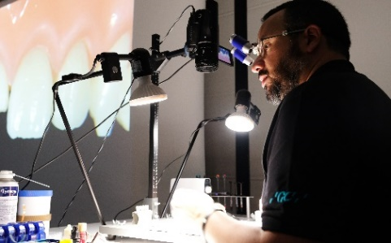
Rules for European Competition
Who can participate?
1st prize winners of each National Contest (1 Junior & 1 Senior student) are awarded with a trip to Leuven to participate in the GC Academic Excellence Final
Tutor of student is invited to join
When?
19 & 20 September 2025
Program?
Day 1 (afternoon):
all local 1st prize winners will present their cases in 5-10 min. max presentations to an International Jury.
dinner in Leuven + award ceremony
Day 2 (full day): Master course on direct restorations with state-of-the-art GC materials.
Final contest in Leuven, Belgium
Day 1: Presentation & Award Ceremony
Day 2: Master Class with hands-on

Slide 10
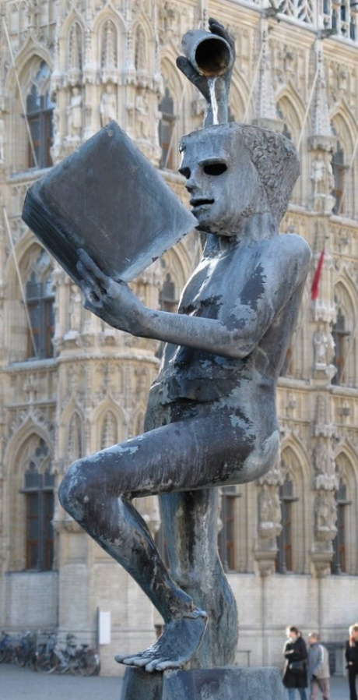
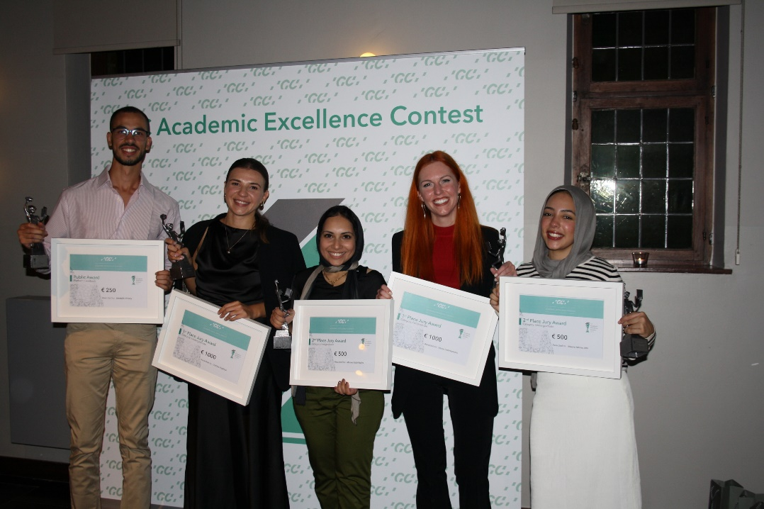
Rules for European Contest
Criteria for selection
Same as National Contest
Awards
1st Prize Senior: 1000 € + publication of an article in GC Get Connected (European Magazine from GC)
1st Prize Junior: 1000 €
2nd Prize Senior: 500€
2nd Prize Junior: 500€
Facebook Prize: 250€ (highest amount of ‘Likes’)
Instagram Prize: 250€ (highest amount of ‘Likes’)
Follow-up
Press release, communication via social media, publication of cases…

Slide 11
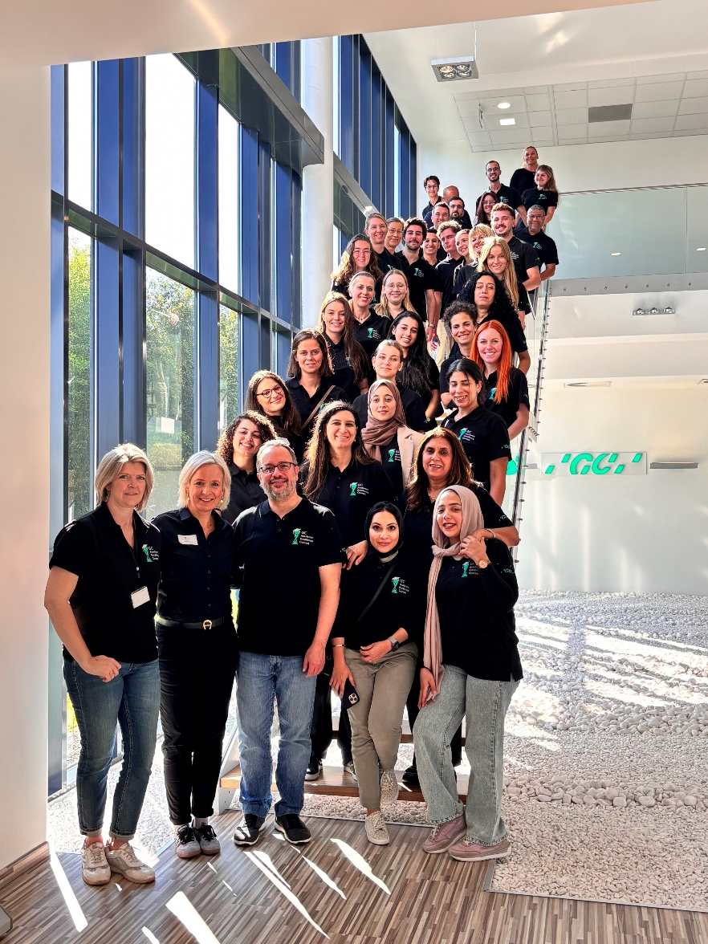
Dates
1 Jan- 5 June 2025: Clinical cases are posted by the students on Facebook and Instagram.
15 June 2025: An independent jury awards the winners at local level & informs names to GCE
1 Sep 2025: deadline for students to send PPT presentation to GCE Leuven
19 & 20 Sep 2025: GC Academic Excellence Contest Final at GCE Campus
Participants to the 2024 Contest

Slide 12
Challenge yourself and join GC Europe Academic Excellence Contest!

